Slide 1
PHASE 1 DESIGN REVIEW PRESENTATION
by Design Corp.
Prepared for:
EML 4551 Senior Design I

Slide 2
MEET THE TEAM
Aaron Burghardt
Project Manager, FSU-PC Mechanical Engineering Student (Senior)
Mandolin Brown
Project Documentation, FSU-PC Mechanical Engineering Student (Senior)
Jack Smith
CAD Design, FSU-PC Mechanical Engineering Student (Senior)
Matthew Thompson
Task Assignment, FSU-PC Mechanical Engineering Student (Senior)

Slide 3
AUTOMATED DOG DOOR: SCOPE
Project Description:
Automated dog door that can be controlled remotely to limit access to a home’s interior or exterior based on constraints such as rain or inclement weather predictions
Project Inspiration:
Desire to limit and control pet access through home interior and exterior
Traditional dog door has faults:
No access limitations causes pets to track mud, dirt, and water into home
Causes interior property damage!
Inadequate security against unwanted creatures/persons entering home
Inadequate security against children/toddlers using dog door

Slide 4
RAIN-DETECTION AUTOMATED DOG DOOR: SCOPE
Objectives:
Design a dog door that will open and shut on command, limiting pet access through door
Design door to sense when dog is approaching and open/close if door is unlocked or stay closed if locked
Sense if obstruction is blocking door from opening or closing
Goals:
Allow consumer to control locking function remotely
Control locking mechanism based on meteorological data, time, and distance
Allow proximity/sensitivity adjustment for sensors on interior and exterior of door
Track number of dogs in interior and exterior of residence
Notify consumer if obstruction is blocking door

Slide 5
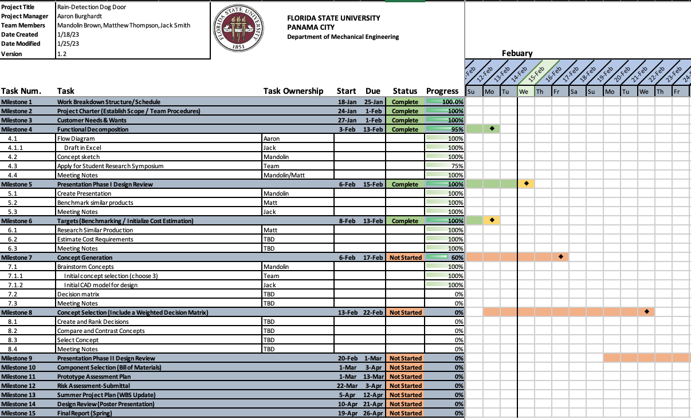
WORK BREAKDOWN STRUCTURE

Slide 6
FUNCTIONAL DECOMPOSITION
Dog Door
Alert
Control
Prevent
Sense
Visual
Auditorial
Phone Notification
Open
Deter Physically
Lockable
RFID Sensor
Weather Sensor
Button(s) for manual overide
Cellphone App override
Inside sensor
Data Collection
Check range preference
Outside sensor
Check range
preference
Determine if aloowed to open
Send open command
Determine if allowed to open
If raining, ignore interior RFID sensor
Check for change in weather conditions/user overide
Scann RFID
Check if allowed to open
Open door
Wait interval
Check for obstruction
Battery life indicator
Send open command
Close door
Weather or user lockout
Obstruction alert
obstruction alert
Battery life indicator
Weather lockout indicator
Manual door override alert
Close

Slide 7
BENCHMARKING/COMPETITOR COSTS
PX-2 Power Pet Fully Automatic Pet Door
Performance PDE Electronic Pet Door
By: High Tech Pet Products
Cost: $540
Most popular competitor model
Ref. [2]
By: Plexidor
Cost: $2780
Most expensive competitor model
Ref. [5]

Slide 8
BENCHMARKING: CONSUMER REVIEWS
Ref. [1]-[3]

Slide 9
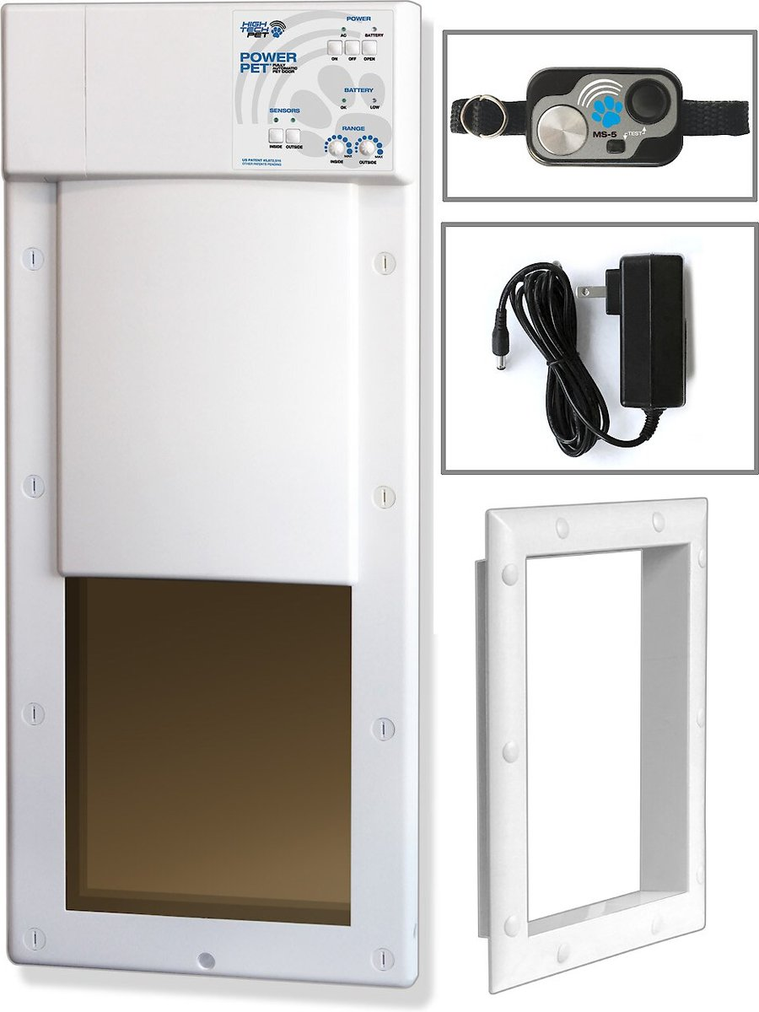
BENCHMARKING: CONSUMER REVIEWS
Primary Product on Market:
Power Pet™ Electronic Pet Door
Pros:
Easy to install
Ample security against unwanted traffic
Notification upon pet entry and exit from residence
Auto-unlock timer constraints
Cons:
Poor battery life on collar
Poor battery life on dog door
App functionality and connectivity problems
Ref. [2]

Slide 10
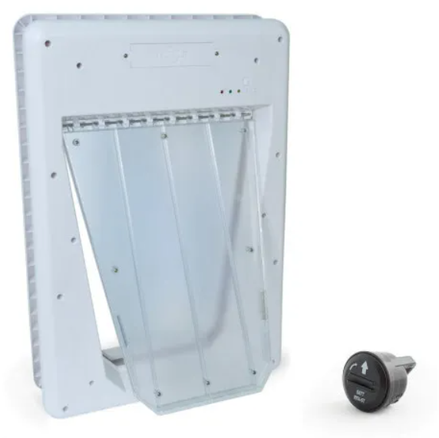
BENCHMARKING: CONSUMER REVIEWS
Primary Product on Market:
PetSafe™ Electronic Smart Door
Pros:
Easy to install
Ample security against unwanted traffic
Notification upon pet entry and exit from residence
Auto-Detect function
$100-$175
Cons:
Poor battery life on collar
Poor battery life on dog door
Tends to jam in the locked position
Can be noisy
Ref.[10]

Slide 11
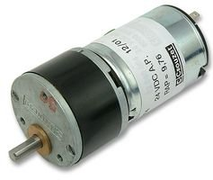
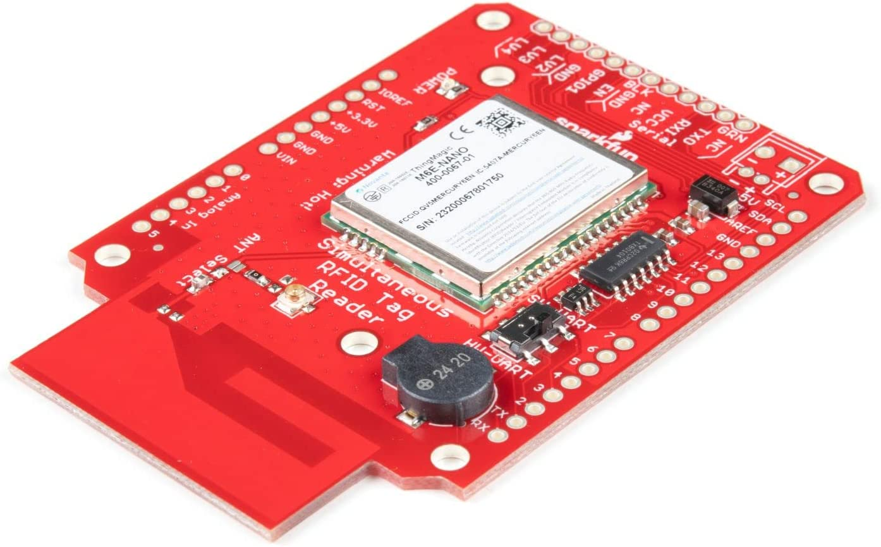
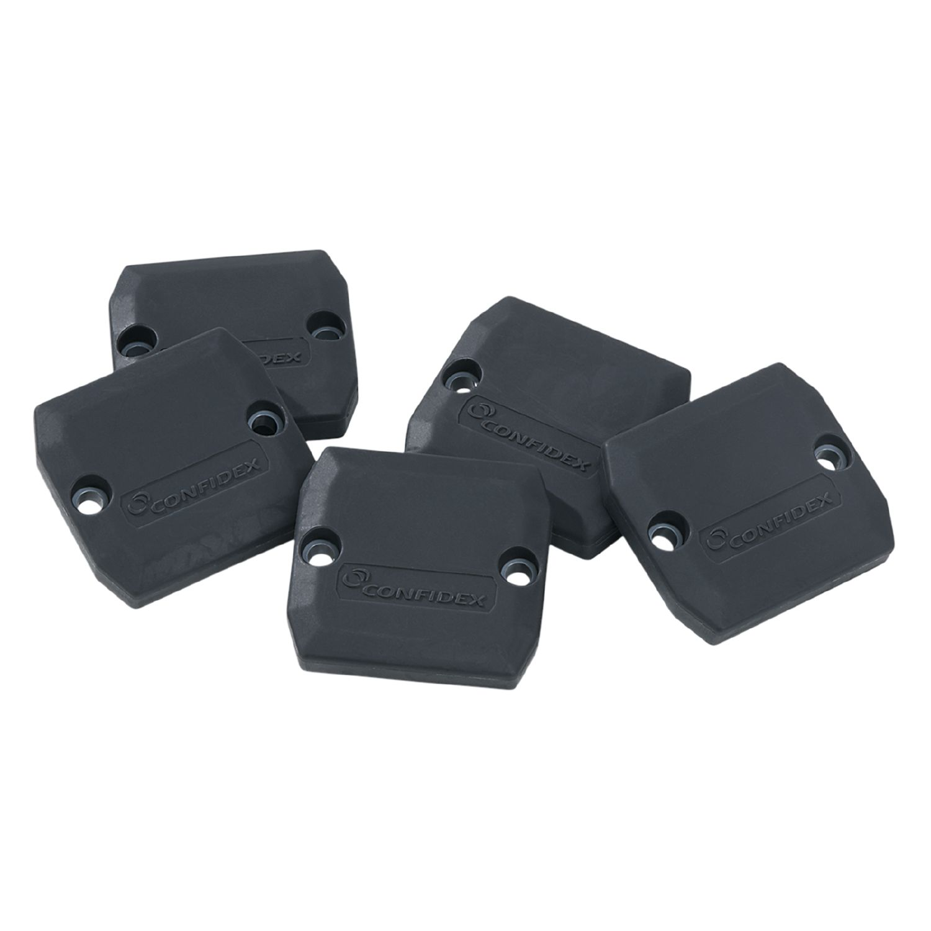
COST CONSIDERATONS
Geared DC Motor: $300.00
UHF RFID Reader: $500.00
UHF Antenna: $200.00
Rugged UHF RFID Tag: $50.00
Building Materials (Plastics, Aluminum, etc.): $500.00
Misc. (Wires, Solder, Bolts, Screws, etc.): $200.00
Total ROM Cost: ~$1750.00
Ref. [7]-[9]
Notes:
Conservative Pricing, Products vary great in price depending on exact needs and quality.
Pictures are for visual representation

Slide 12
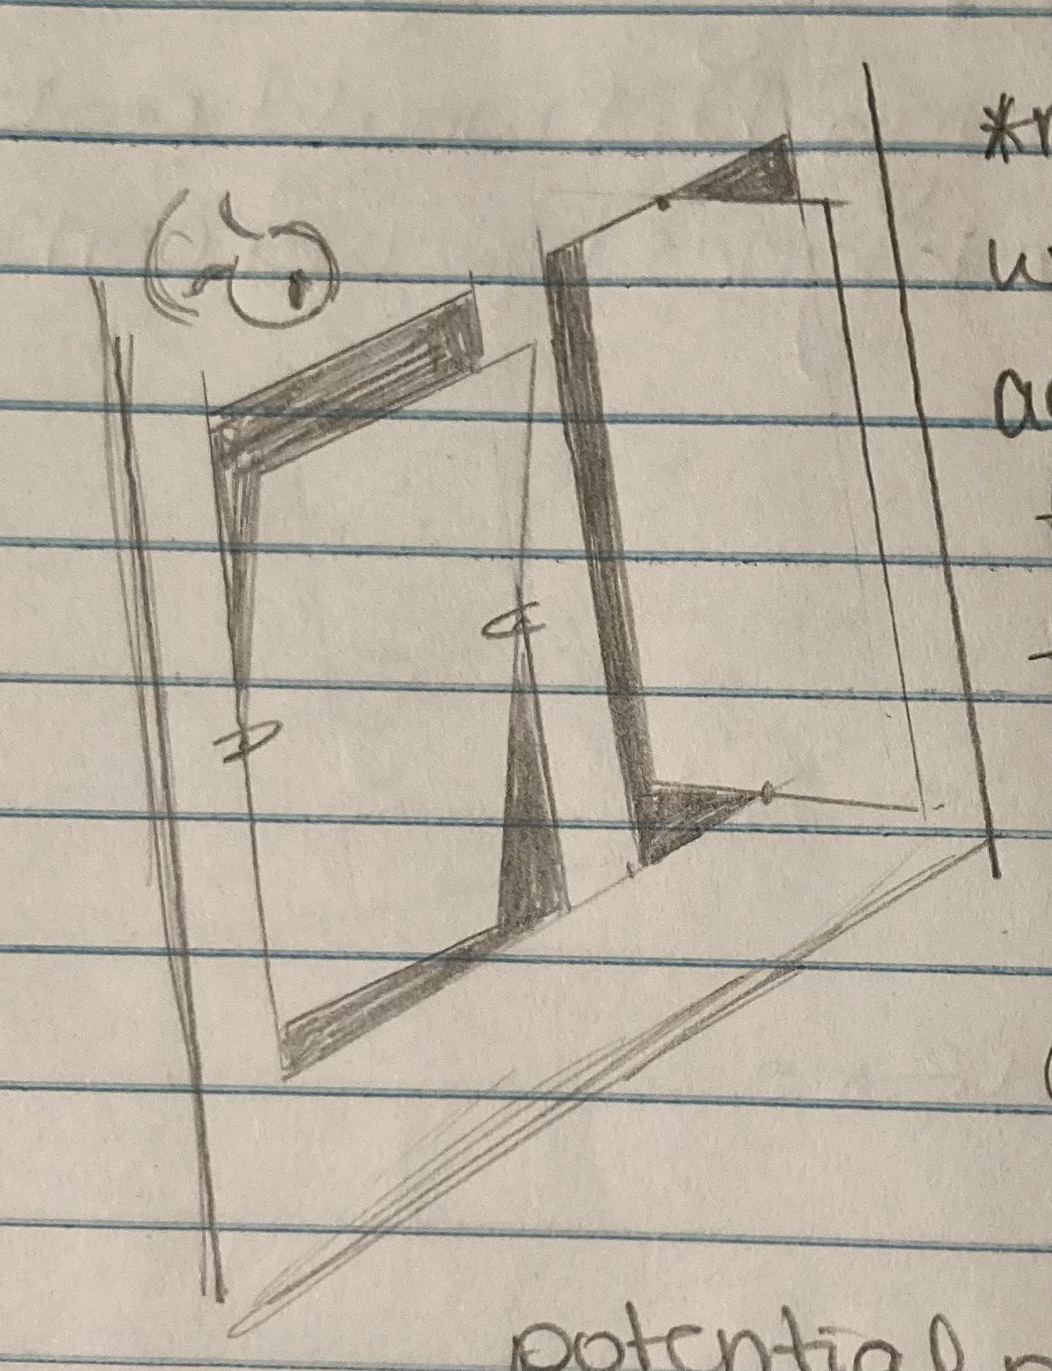
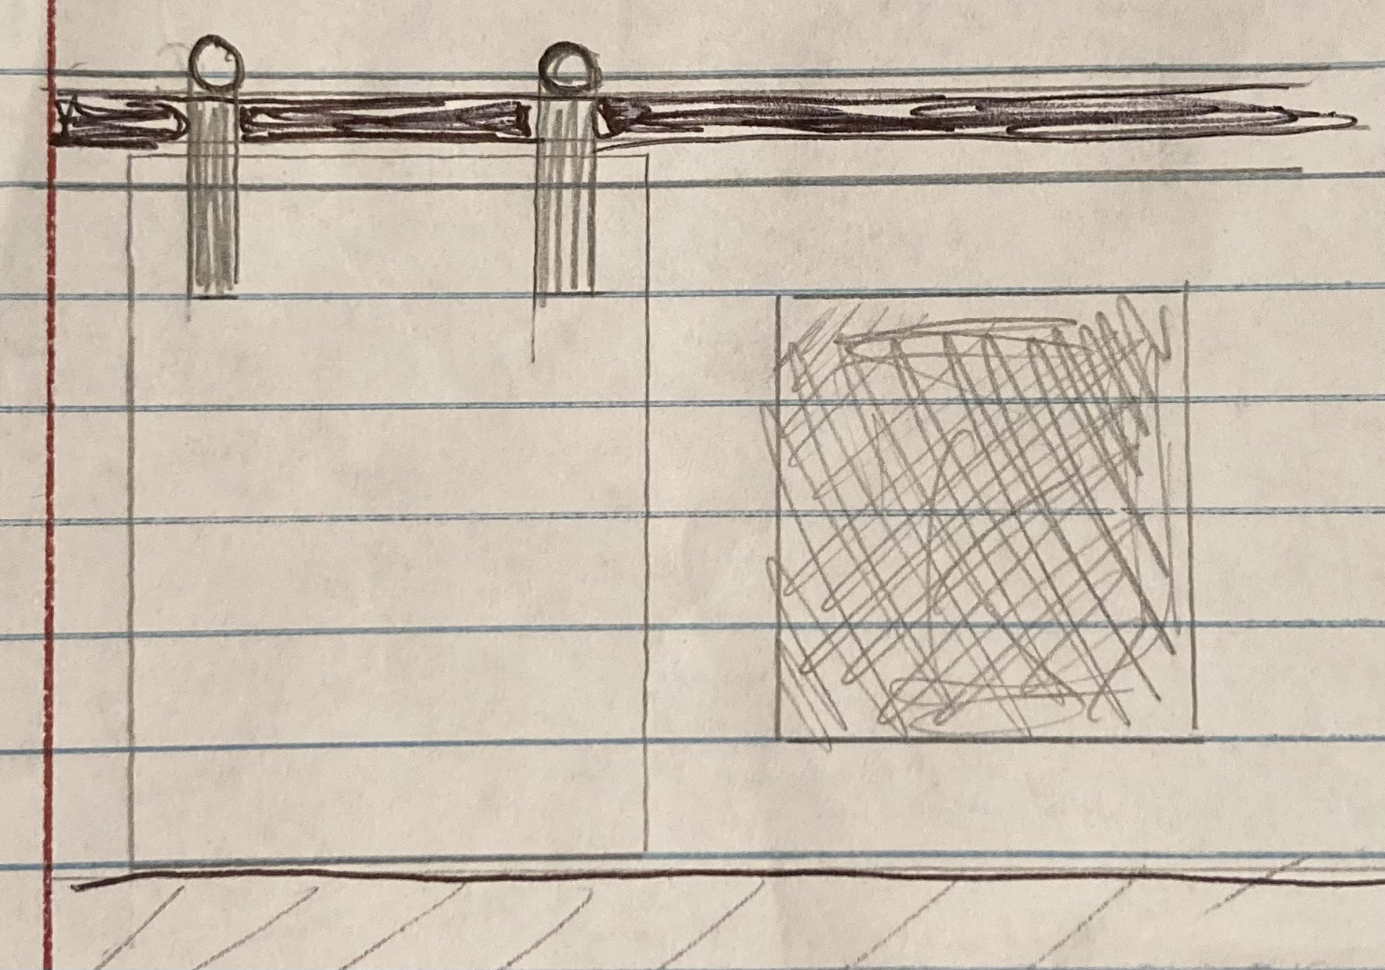
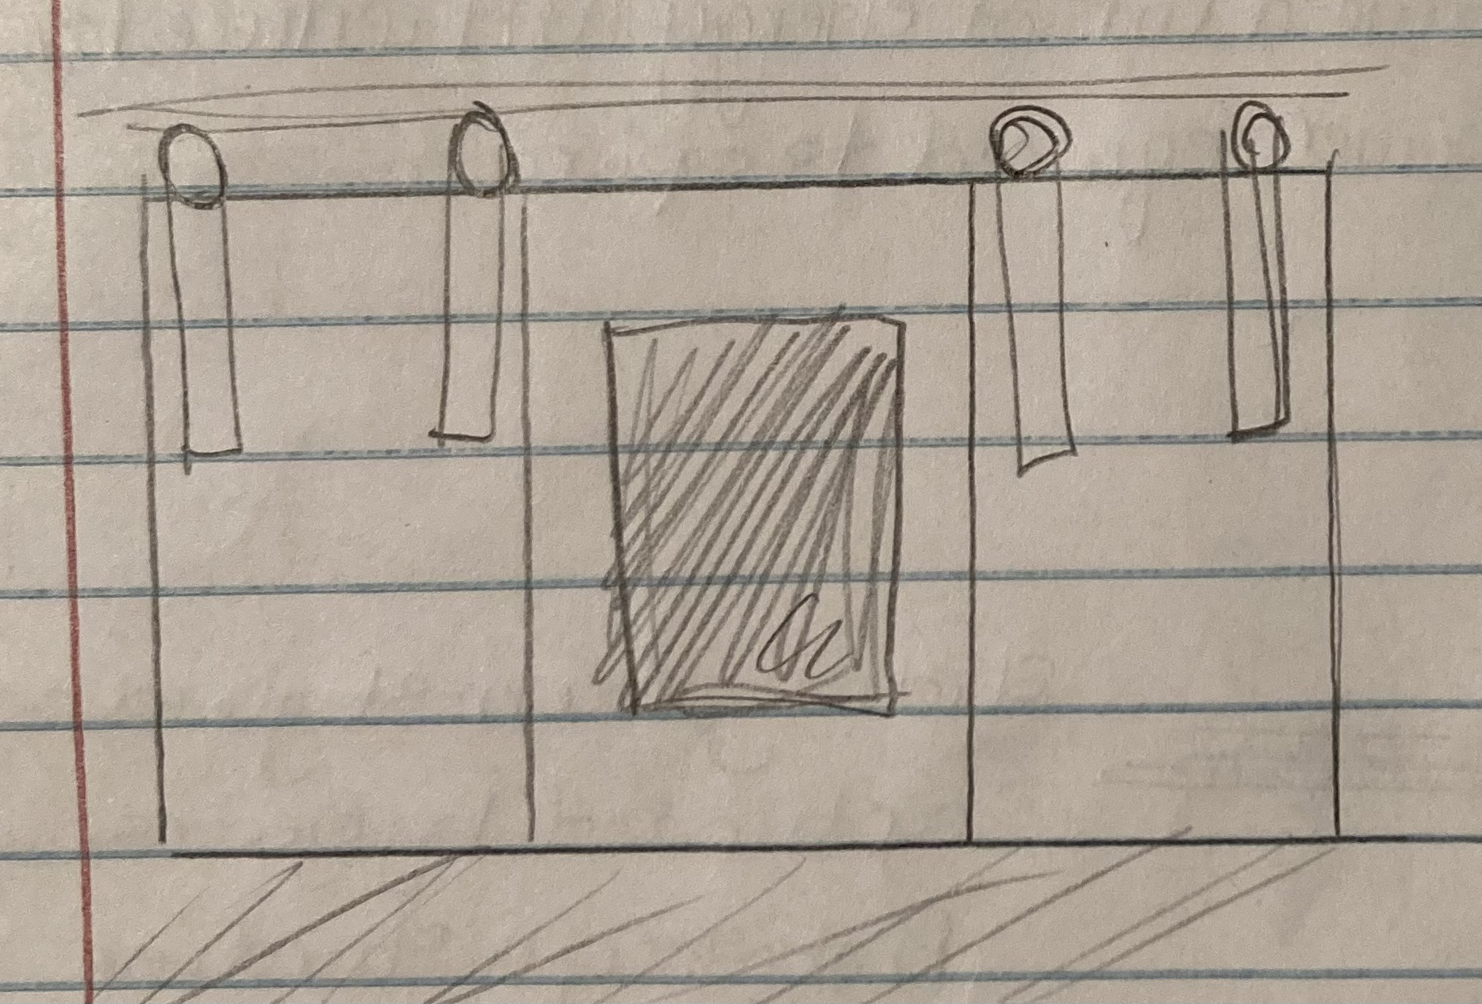
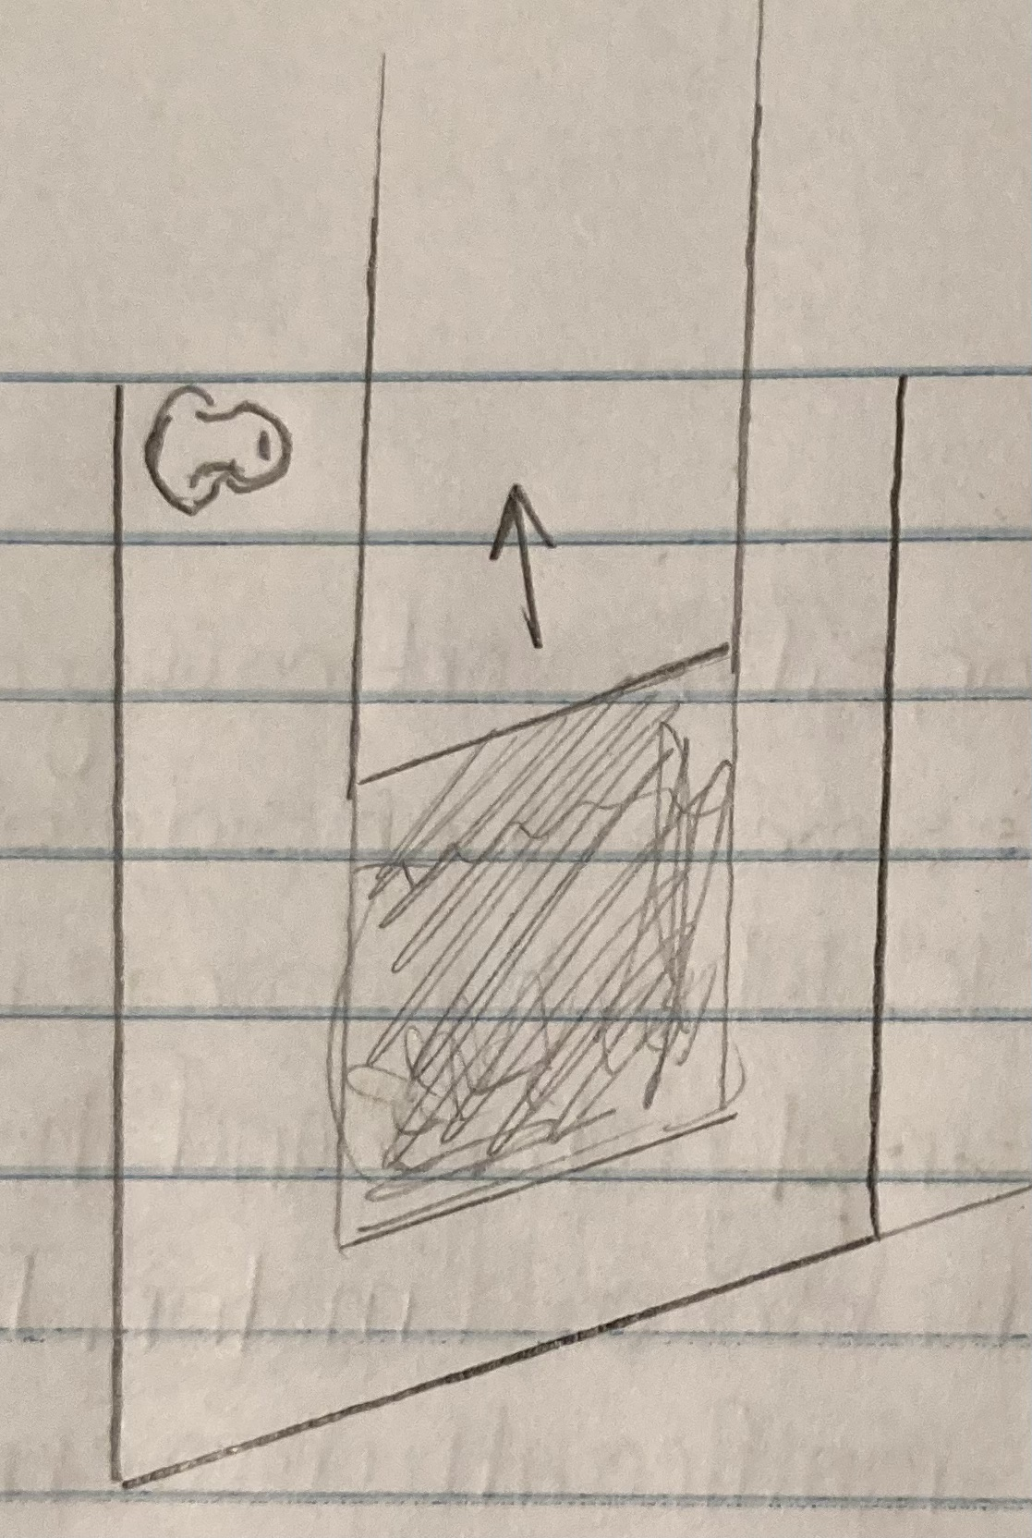
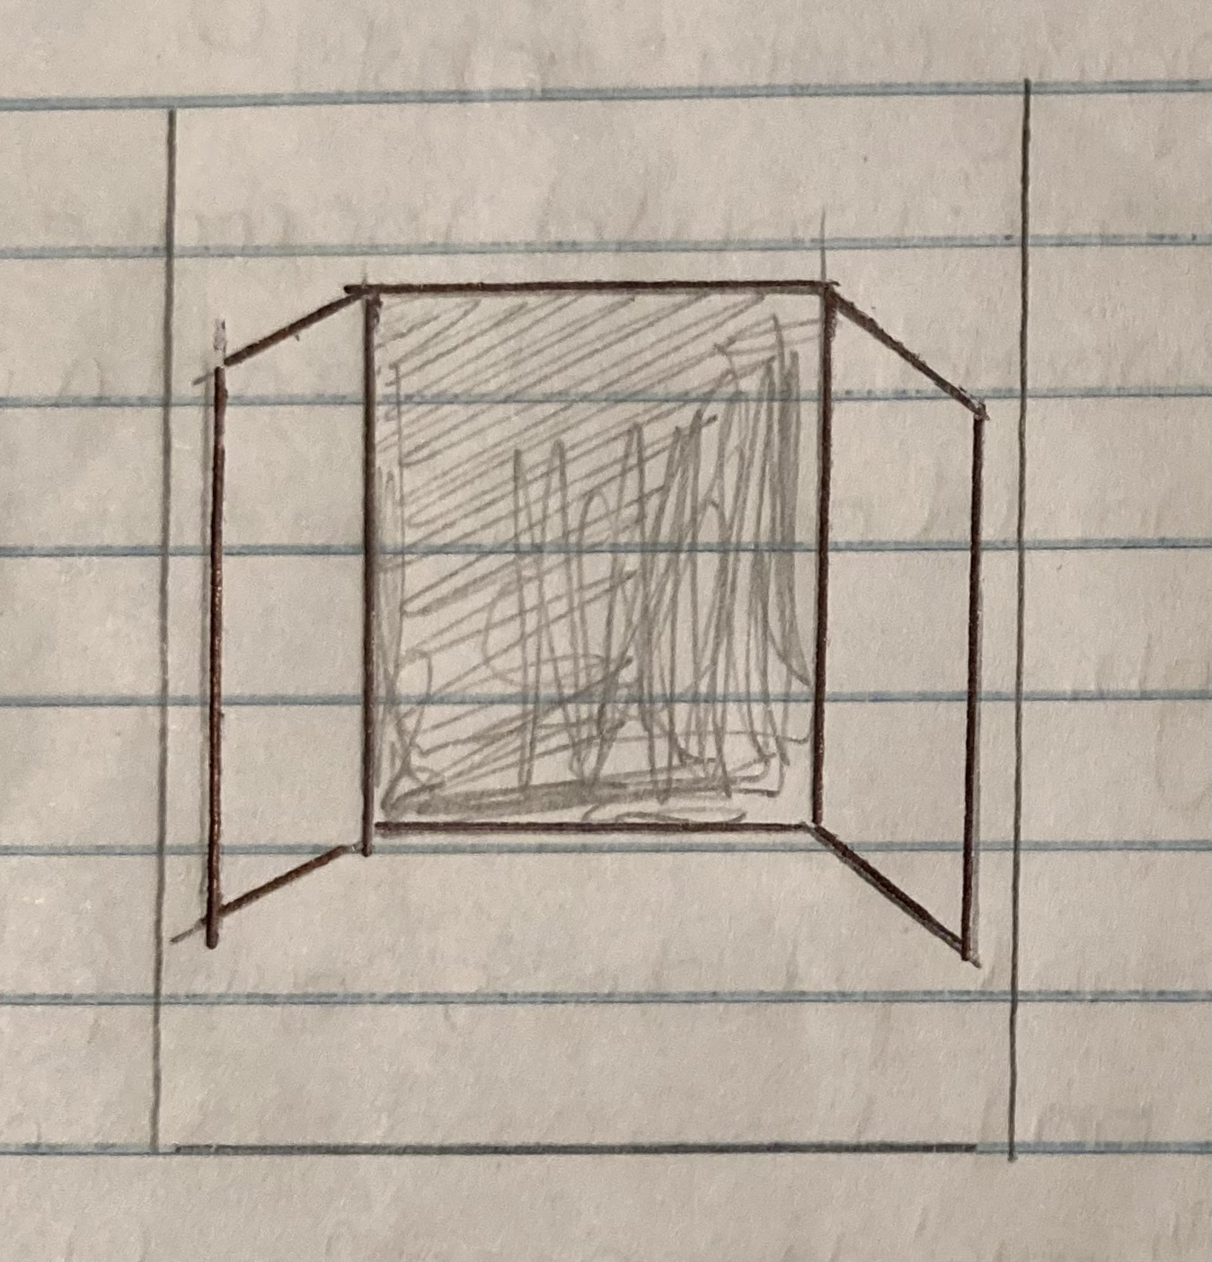
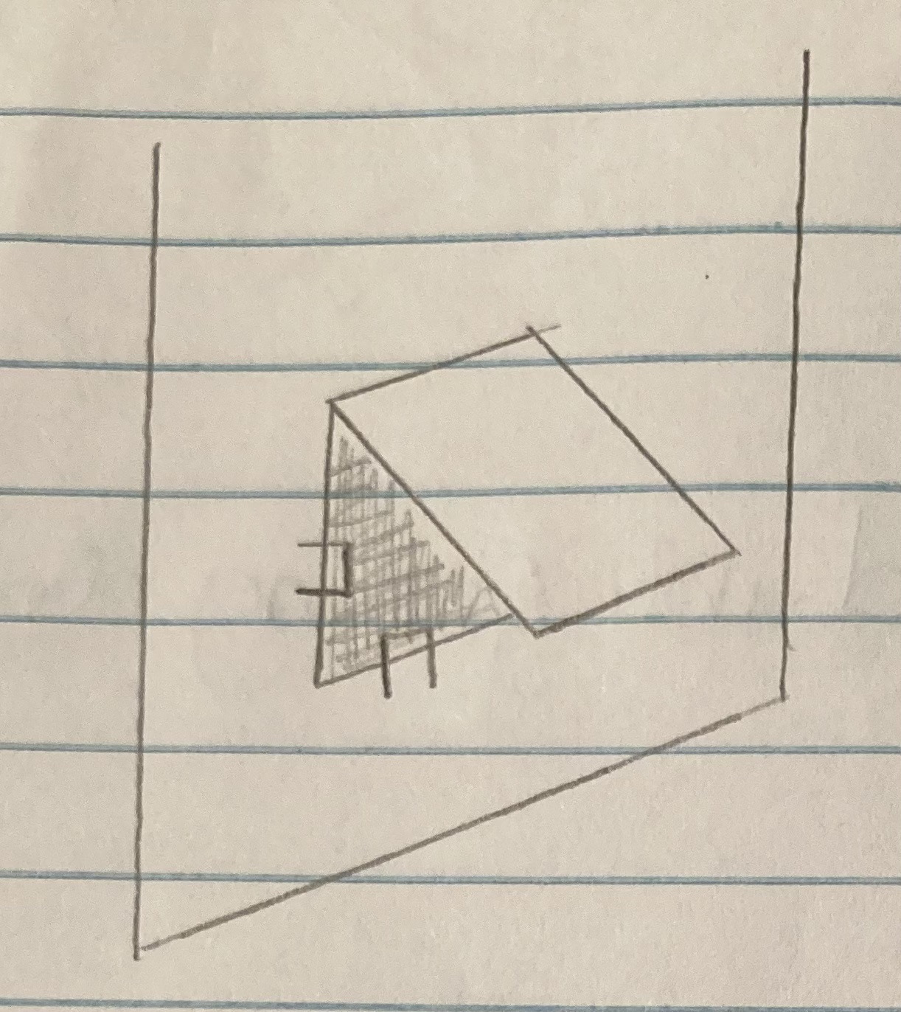
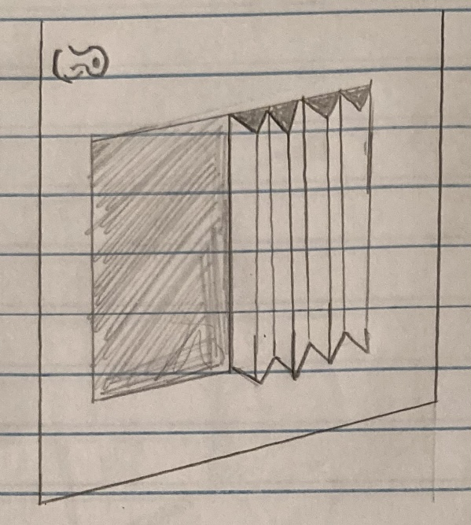
BRAINSTORMING AND CONCEPT GENERATION
Several concepts were considered based on:
Functionality
Feasibility
Simplicity
The best concepts from this lot were selected
⭐️
⭐️
⭐️
Drawings by Mandolin Brown

Slide 13
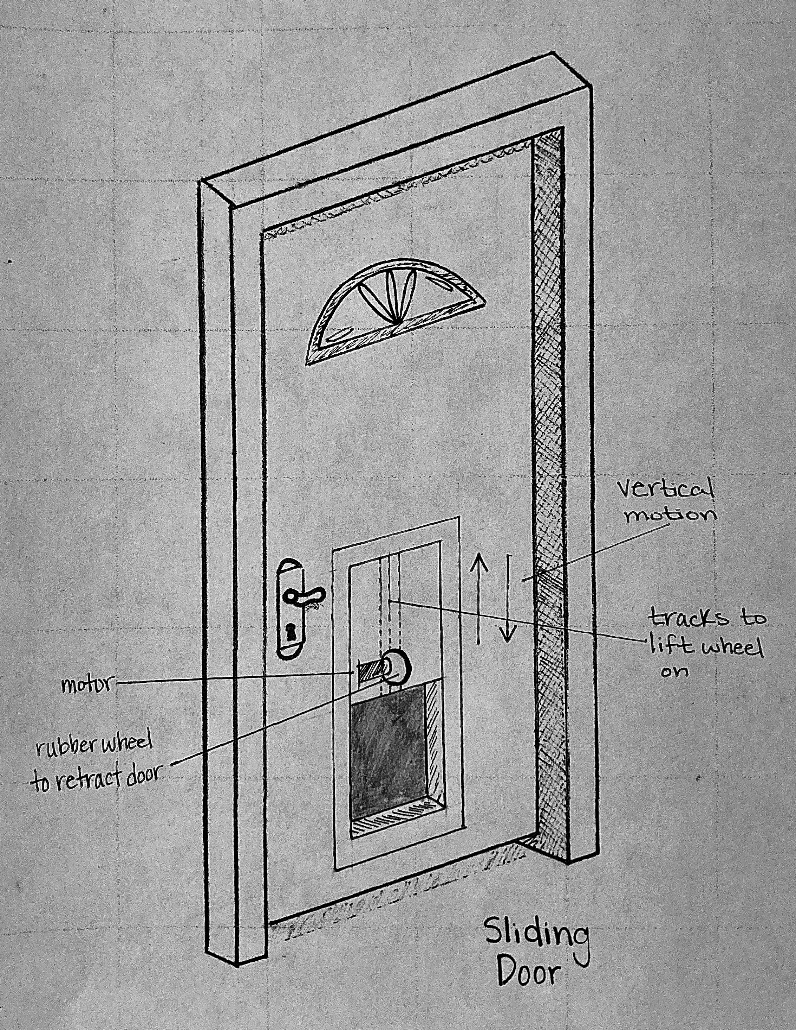
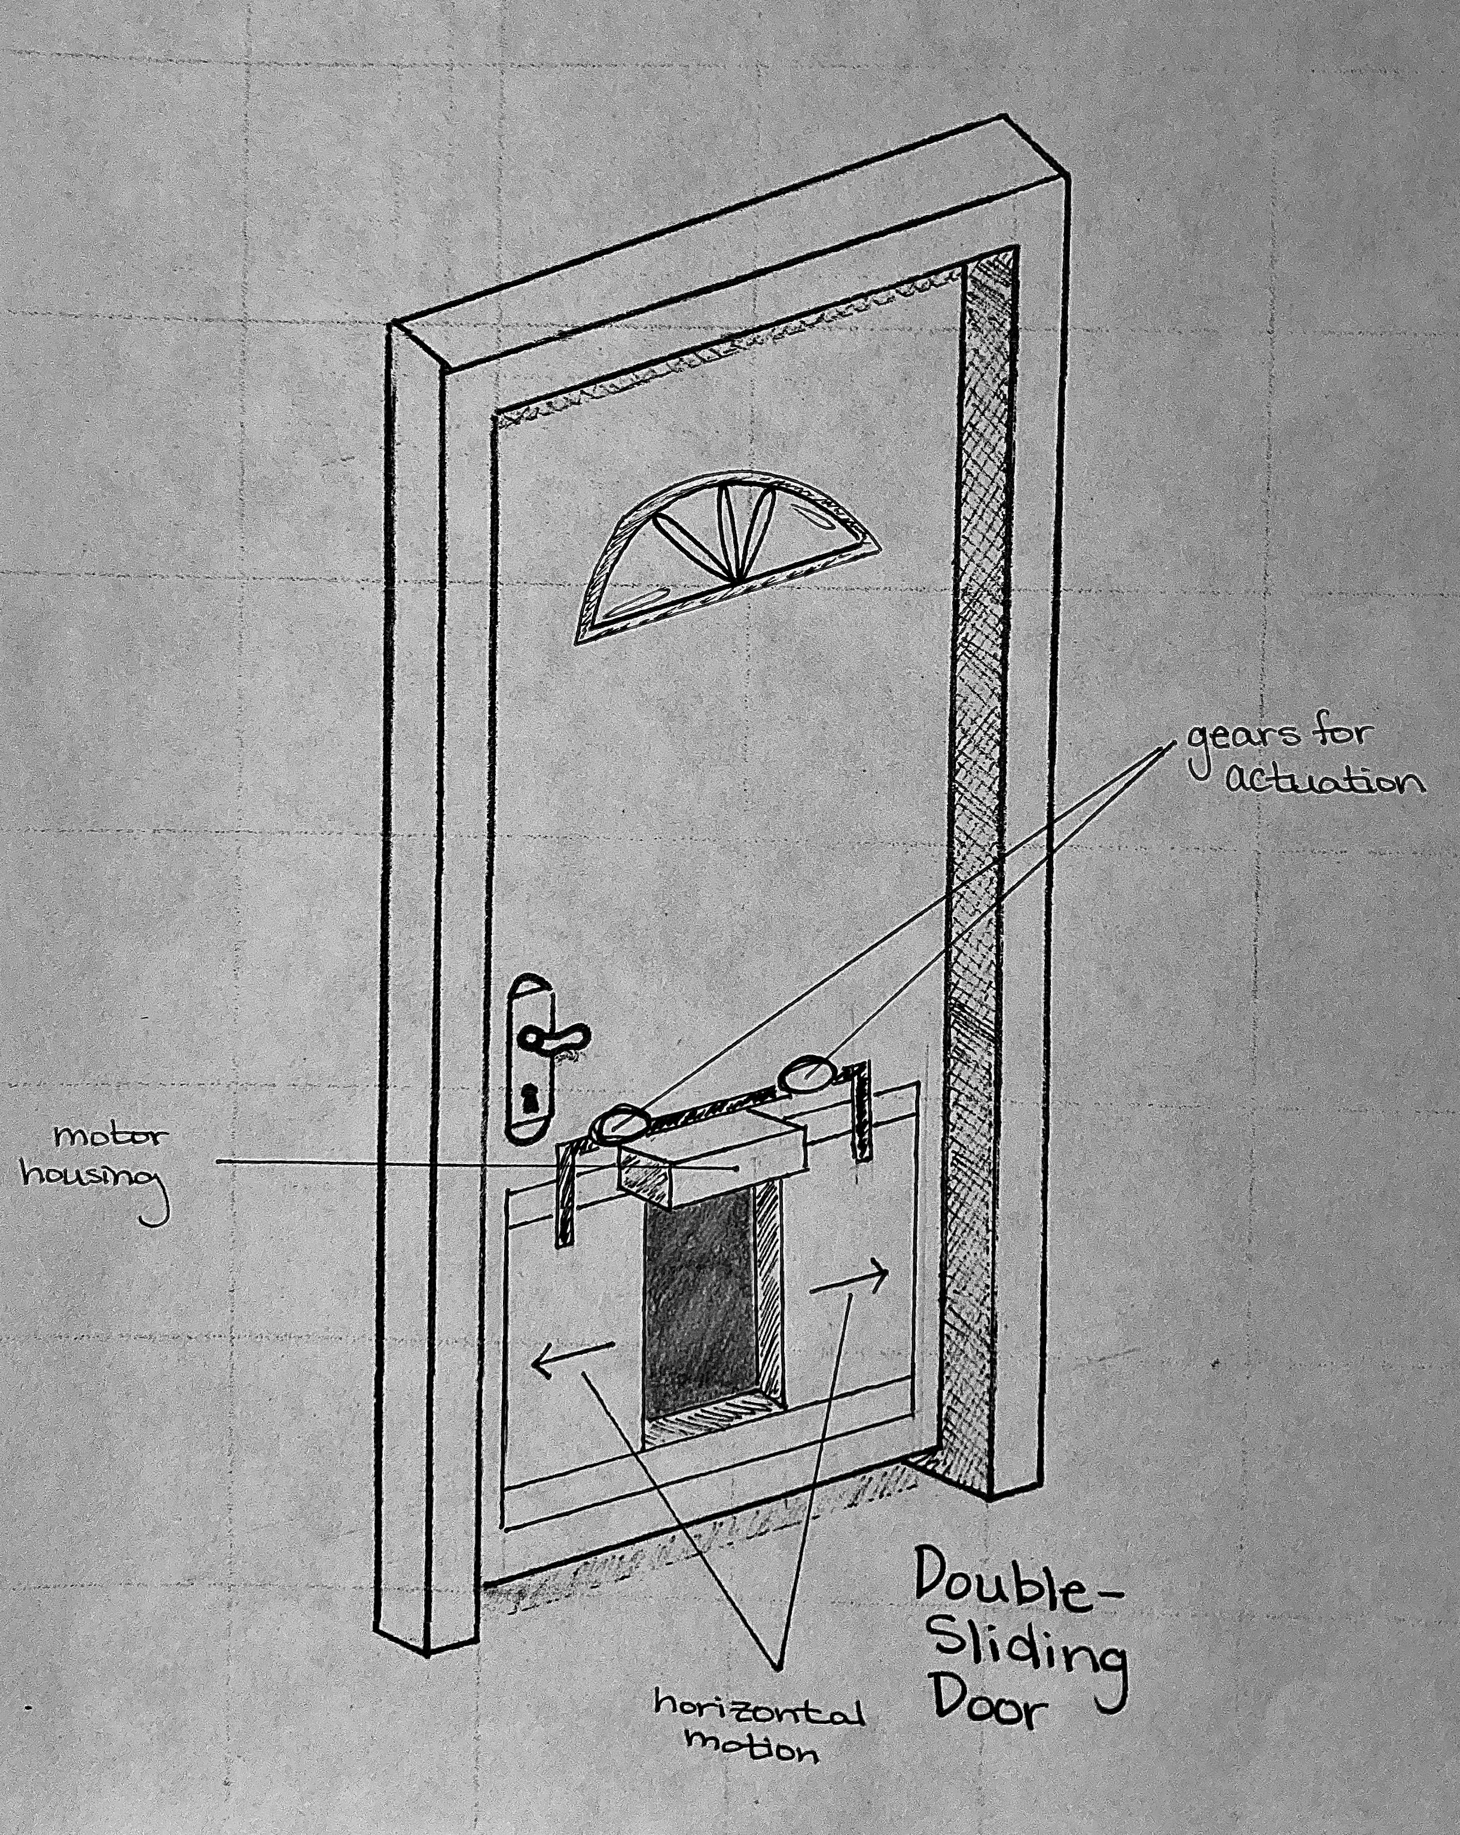
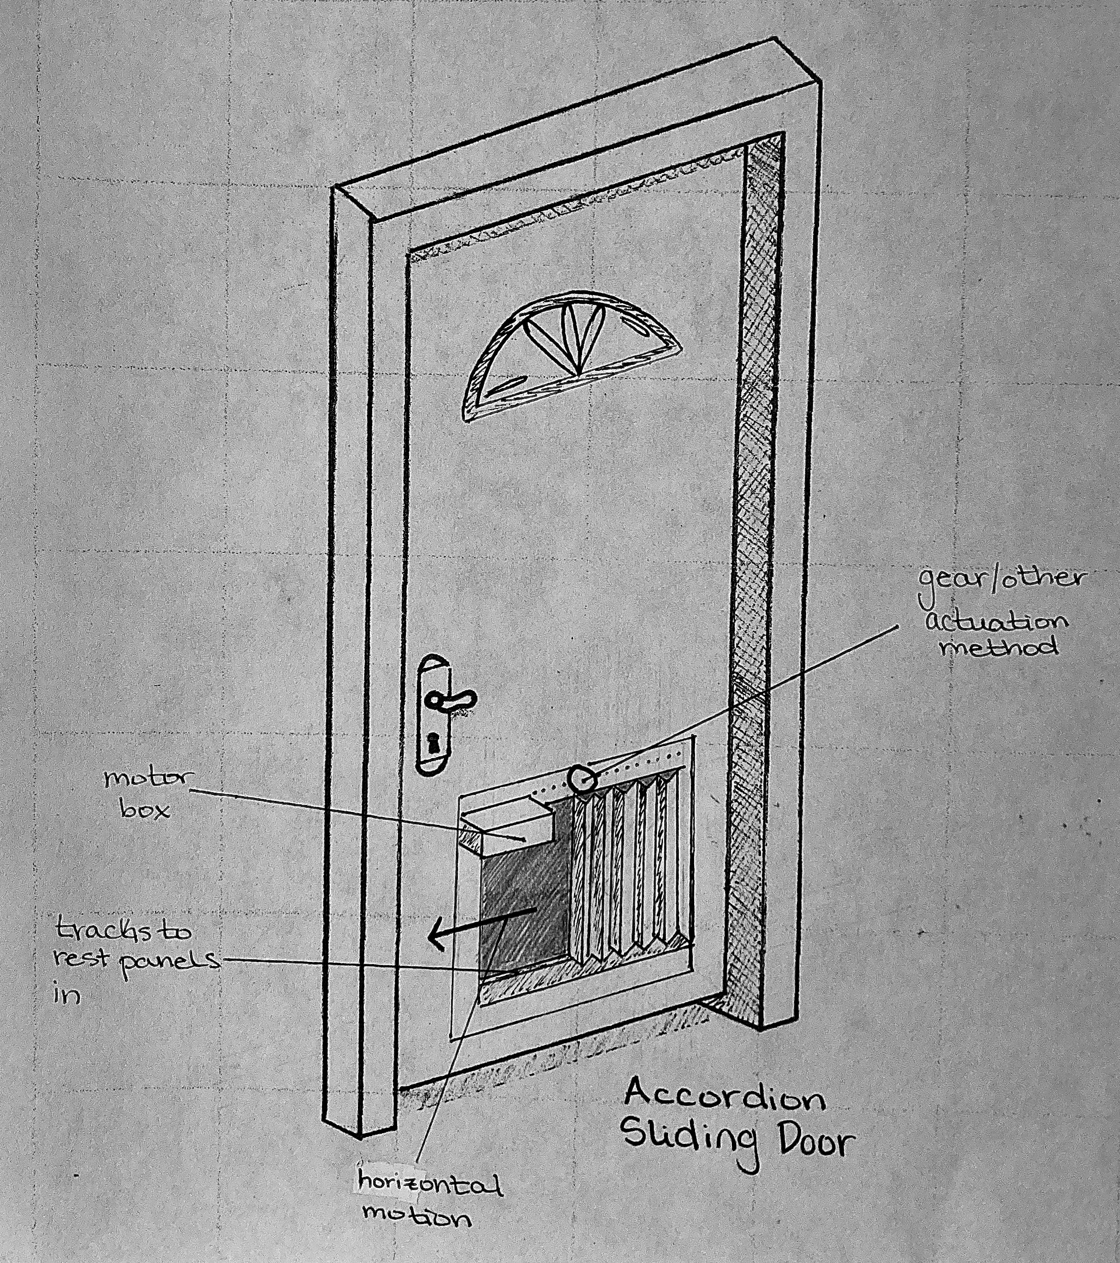
SELECTED CONCEPTS
Double-Sliding Door (Horizontal)
Accordion-Fold Door (Horizontal)
Sliding Door (Vertical)
Drawings by Mandolin Brown

Slide 14
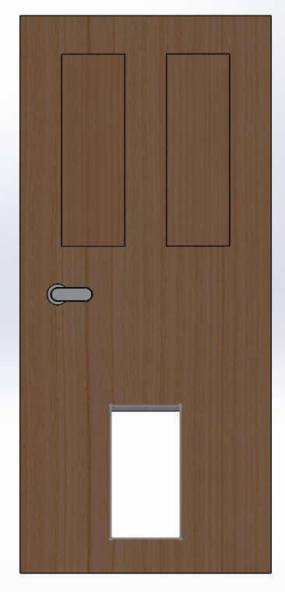
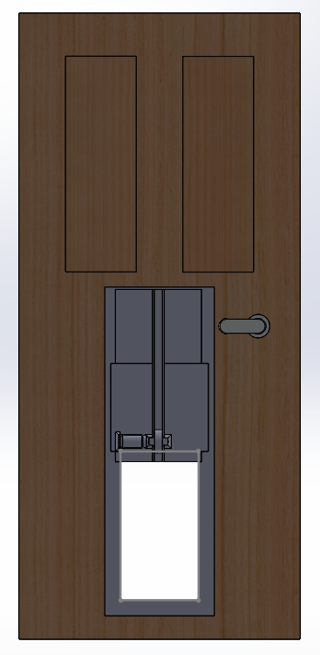
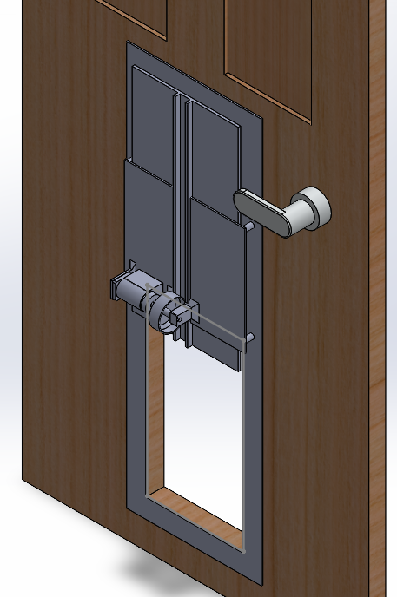
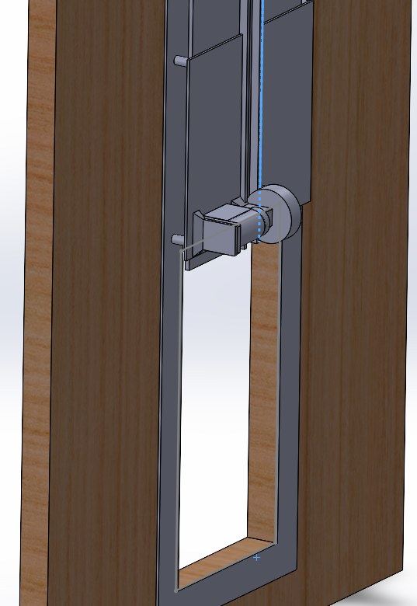
PROPOSED CONCEPT
Modeled by Jack Smith

Slide 15
REFERENCES
[1] “High Tech Pet Products WIFI Enabled Smartphone Controlled Automatic Dog & Cat Door, Large.” HIGH TECH PET PRODUCTS WiFi Enabled Smartphone Controlled Automatic Dog & Cat Door, Large - Chewy.com, https://www.chewy.com/high-tech-pet-products-wifi-enabled/dp/290941?utm_source=google-product&utm_medium=cpc&utm_campaign=12646124820&utm_content=High+Tech+Pet+Products&utm_term=&gclid=CjwKCAiArY2fBhB9EiwAWqHK6jyK2NunA2wIFciTCCK33fB2gEpFsnpmpaluL7YMuM8rClrE5xhY5RoCSM8QAvD_BwE.
[2] “Model PX-1 Medium Standard Power Pet ® Door for Cats and Dogs up to 30 Lbs.” Model PX-1 MEDIUM STANDARD POWER PET ® DOOR for Cats and Dogs up to 30 Lbs., https://www.hitecpet.com/autpetdoorfo1.html?gclid=CjwKCAiArY2fBhB9EiwAWqHK6j2JvIJgLPCEElA0fKJjOyANUxx9dU3MXy4zqGFiMWj2RwjOmo62MhoCIq0QAvD_BwE
[3] High Tech Pet Power Pet Door for Door and Wall Installations, Medium ... https://www.petco.com/shop/en/petcostore/product/high-tech-pet-power-pet-px-1-pet-door-medium-1506935
[4] “High Tech Pet Power Pet Medium Electronic Pet Door PX-1.” https://www.amazon.com/High-Tech-Pet-Electronic-PX-1/product-reviews/B003SLICOO/ref=cm_cr_unknown?ie=UTF8&reviewerType=all_reviews&filterByStar=one_star&pageNumber=1
[5] PlexiDor Performance PDE Electronic Pet Door for Dogs and Cats - Wall Mount Dog Door - White, Large. https://www.amazon.com/PlexiDor-Performance-Pet-Doors-Electronic/dp/B003FOI9TC/ref=sr_1_11?crid=3R38HEQVBYPV8&keywords=automatic+dog+door+plexidor&qid=1676495960&s=pet-supplies&sprefix=automatic+dog+door+plexidor%2Cpets%2C86&sr=1-11&ufe=app_do%3Aamzn1.fos.17f26c18-b61b-4ce9-8a28-de351f41cffb
[6] 6 Best Smart Dog Doors. familyhandyman.com/list/6-best-smart-dog-doors/?_cmp=stf
[7] Geared DC Motor, 12 V, 3.9 W, 141 RPM, 0.5 N-m: Amazon.com: Industrial & Scientific
[8] https://www.sparkfun.com/products/14066
[9] https://www.atlasrfidstore.com/omni-id-exo-750-rfid-tag
[10] https://store.petsafe.net/electronic-pet-door
[11] https://www.istockphoto.com/photo/splashing-around-gm516621517-48376614

Slide 16
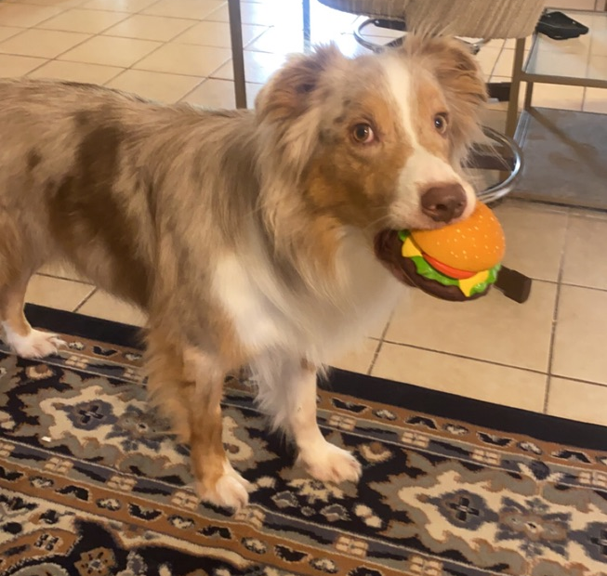
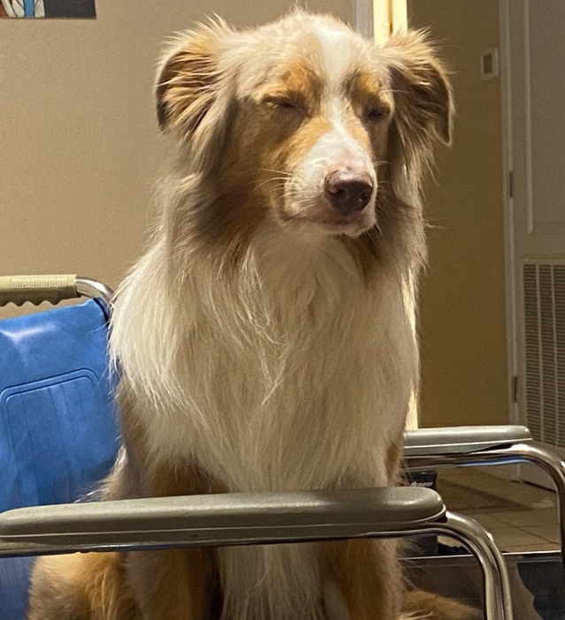
QUESTIONS?
QUESTIONS?

